Slide 1



CNR
www.cnr.it
DSSTTA
www.dta.cnr.it
ISMAR - IAS - IRBIM
www.ricercamarina.it
RDBfis statistical workshop.
Italy DCF fishery samples and raising procedures
Virtual, 16 January 2025
Alessandro Mannini
Technologist IRBIM
Istituto per le Risorse Biologiche e le Biotecnologie
Marine
alessandro.mannini@irbim.cnr.it

Slide 2
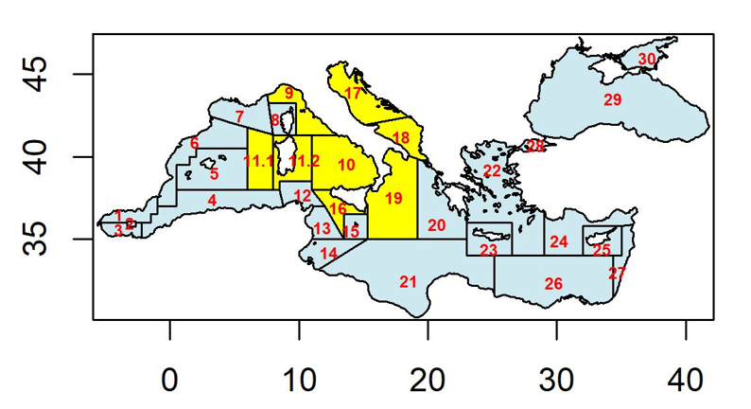




CAMPBIOL – Italian Institutes
National Research Council - Institute for Biological Resources and Marine Biotechnology: CNR-IRBIM Ancona, Messina and Mazara del Vallo
Consorzio per il Centro Interuniversitario di Biologia Marina ed Ecologia Applicata “G. Bacci" (CIBM)
COISPA Tecnologia & Ricerca Scarl, Stazione Sperimentale per lo Studio delle Risorse del Mare
Consorzio Nazionale Interuniversitario per le Scienze del Mare (CoNISMa)
IRBIM – Istituto per le Risorse Biologiche e le Biotecnologie Marine
Home - CIBM - Centro Interuniversitario di Biologia Marina
Coispa tecnologia e ricerca
CoNISMa – Consorzio Nazionale Interuniversitario per le Scienze del Mare

Slide 3
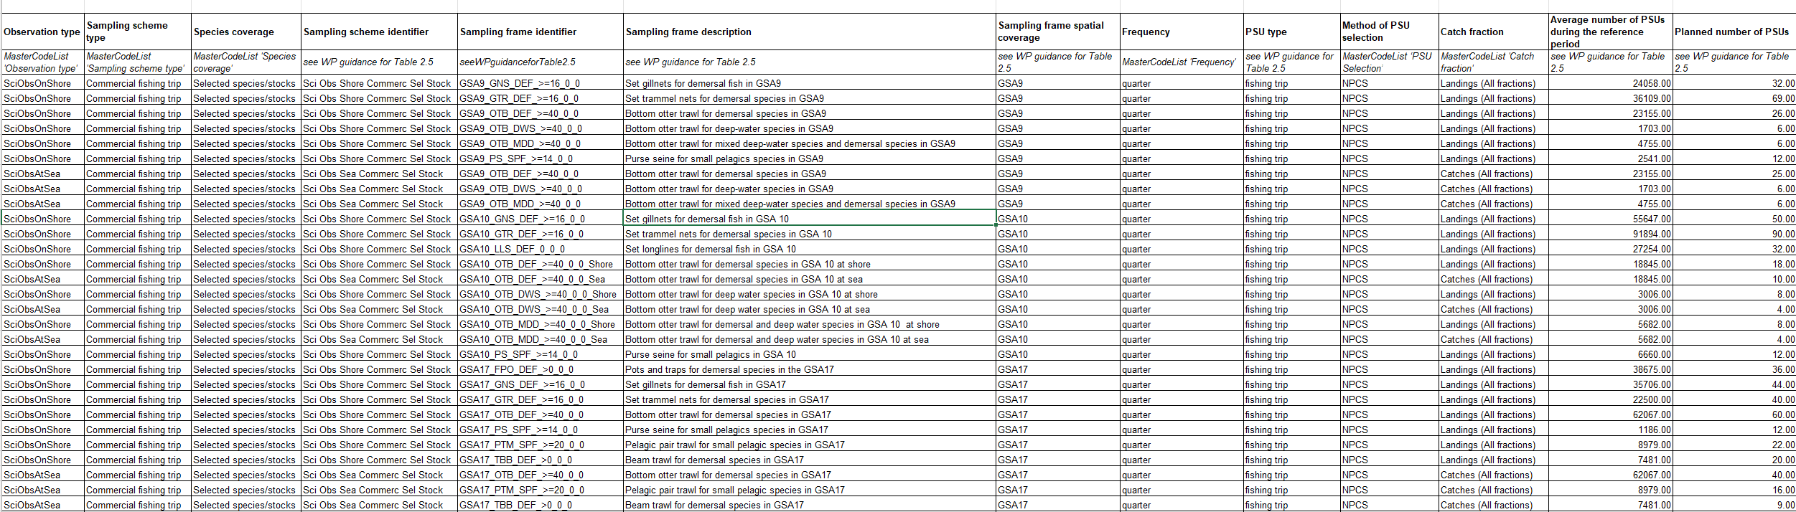

The sampling unit shall be the fishing day and the number of fishing days to be sampled shall ensure a good coverage of the trade. During a fishing day, all species shall be sampled simultaneously, with different priorities according to the group to which they belong (group 1, 2 or 3 species, in that order of importance).
WPs and ARs - European Commission

Slide 4
How the samples are raised to the total production?
Vigneau & Mahevas
Trip raising
Trip raising then Vigneau & Mahevas
VIGNEAU J, MAHEVAS S, 2004. Precision in catch at age data with regard to sampling design, Working document for the WKSMFD (Nantes 26-31/01/2004): 26 pp

Slide 5
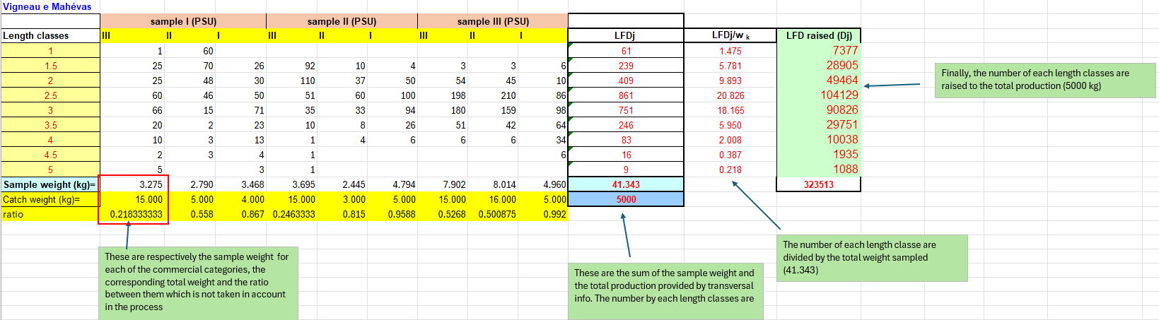
1) Vigneau & Mahevas
For a given sample (PSU), the Vigneau-Mahevas method treats all the commercial categories sampled as different samples, without taking into account the sample/market ratios of the different categories, which are calculated as the sum of the individuals of the different samples for each length class and extended to the total landings of the stratum.

Slide 6
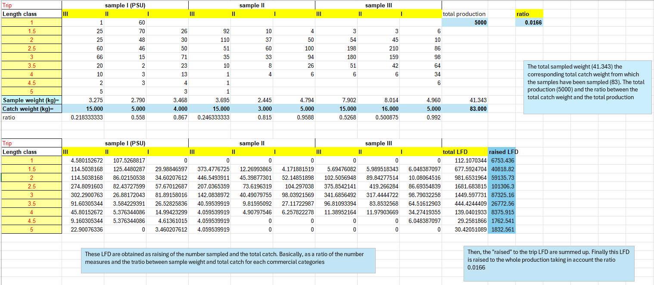
2) Rising to the trip (no Vigneau & Mahevas)
The samples by each commercial categories are raised to the corresponding sample ratio (basically weighted by the subsample applied to each commercial categories). The resulting LFDs for each commercial categories are summed to obtain the final LFD of a given trip. The LFDs are summed to obtain the final sampled LFD (by quarter/year level and métier) and raised according to the ratio between the total weight sampled and the total production provided by the transversal data collection.

Slide 7
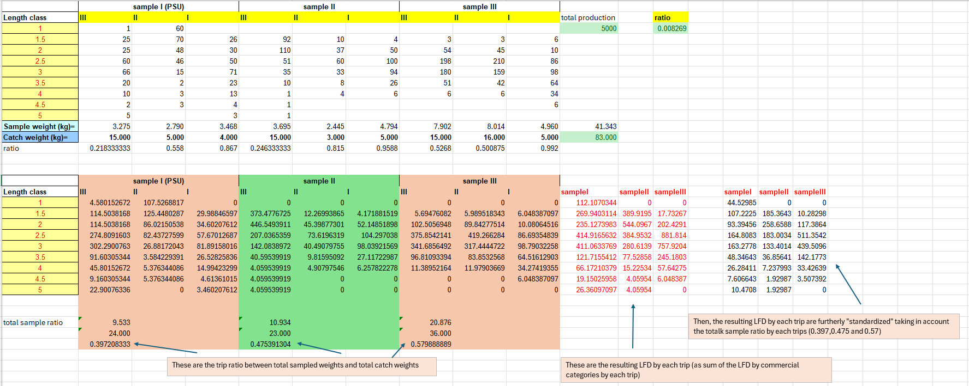
3) LFD raised to the trip are used as input in the Vigneau & Mahevas process
LFDs by commercial category are raised to the corresponding sample ratio. For example, with 3 categories for A. antennatus: category I as sampled 5kg out of 5kg caught sample ratio (5/5=1), category II as sampled 5kg out of 10kg observed (5/10=0.5) and for category III as sampled 5kg out of 20kg observed (5/20=0.25).These 'extended' LFDs are then added together to produce a single commercial LFD, which is corrected in its numerosity by length class by multiplying each length class by the total sample ratio (in this case sample weight 5+5+5=15 and total weight 5+10+20=35 giving a total sample ratio = 15/35) and used as input (single LFD observation) in the Vigneau-Mahevas calculation process.

Slide 8
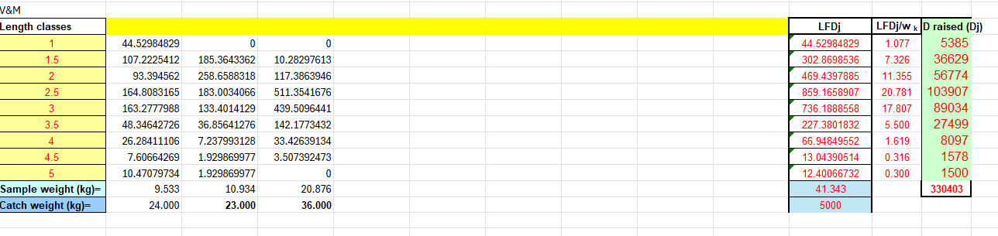
As said, the resulting LFDs are the input for the M&V process to get the raised LFD

Slide 10
RAISING OF LENGTHS OF LANDINGS Minimum requirements for the raising of the sample data to landings
Are there 2 samples for each quarter in the metier (>= 40 individuals each quarter)?
NO: are there 2 quarters sufficiently covered (>=20 individuals each)?
YES: raising by metier per year
NO: the fishing and/or the species are not regularly occurring;
(1) at least 2 samplings with 20 individuals in total are available; (2) at least 2 samplings with at least 40 individuals in one quarter.
YES: raising by metier per quarter
YES: raising by gear (OTB) per year
NO: in case of Trawlers: are there at level 4 (allowed only for OTB) 2 quarters sufficiently covered (>=20 individuals each)?
YES: raising by metier per year
NO: The data is not raised
Thanks COISPA

Slide 11
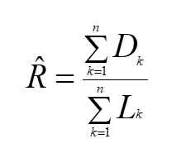
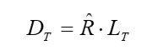
DISCARD estimation
The total amount of discard by target species (G1, G2 and G3) and by metier, knowing the amount of landings, will be
estimated as a “ratio estimator” according to Cochran (1977). The average discard rate (R) by species and by metier is calculated as:
Cochran W.G., 1977. Sampling techniques (3rd edition). John Wiley & Sons, New York, USA, 428 pp.
Where (D) is the discard and (L) is the land for each trip k and n the number of observations.
The average discard rate is estimated for both the number of individuals and the weight.
Given the total production (Lt), the total discard (Dt) is estimated using the formula:
The average discard ratio by species and quarter could be affected heavily by the sample (due to change in local market request, MCRS, relative species abundance, etc). Indeed, the range could varies between ∞ «all discarded» to 0 «all retained». Discard is very challenging to be estimated properly.

Slide 12
RAISING OF LENGTHS OF DISCARDS
Thanks COISPA
The same aggregations used for landed fish are applied to discards.
Expansion of sample data to production requires at least 20 individuals sampled, with coverage of two quarters, or 30 individuals for seasonal catches.
First step: calculation of the annual ratio on weight (R=disc_sampl_weight/land_sampl_weight) because considered more robust and less subject to inaccuracies due to sampling.
Second step: the product of the annual ratio (R) by the sum of the production of the quarters in which the discard was detected (L) leads to the annual discard volume (R*L). In this way, overestimation of the annual discard is avoided, especially in cases of species with seasonal discard (e.g., red mullet).
Third step: raising of the LFD of the discard, according to two different options:
If expansion is by quarter, the quarterly discard volume is calculated following specific steps:
The sample percentage of discard is calculated as the ratio of quarterly discard weight to the annual discard weight.
The quarterly discard volume is obtained by multiplying the annual discard volume by the sample percentage, which is then used to expand the quarterly sample LFDs, with the annual discard expansion being the sum of the quarterly ones.
If landed data is aggregated by year, the discard LFDs by quarter are summed up and expanded to the annual discard volume.
Notes:
The first step is the calculation of the annual ratio. Using the sample data of commercial landed (of the days of detection of the discard) and discard, according to the aggregations used for the raising of the landing, the annual weight ratio of the discard is calculated as the ratio between the sample quantity of discard and the sample quantity of landed.

Slide 13
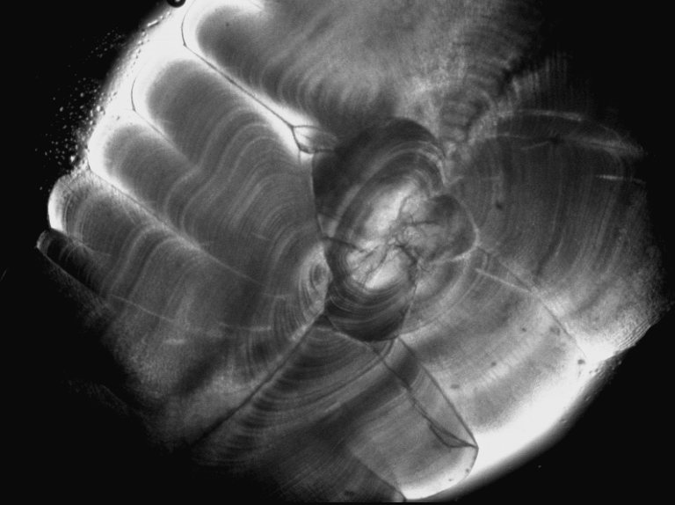
Catch at age
Once the length structure of the commercial catch has been estimated, the age structure of the catch is reconstructed from the available data using two main approaches:
the use of the slicing procedure, which allows a rapid conversion of LFDs into age structures in the presence of a reliable von Bertalanffy function (VBGF) parameter estimate;
the use of age-length keys (ALKs) to estimate the proportions of different age classes within each sampled length class. This procedure is only feasible in cases where it is possible to estimate the age of individual animals, e.g. by reading otoliths.

Slide 14
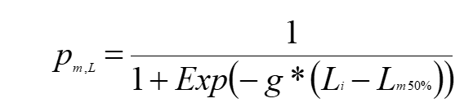
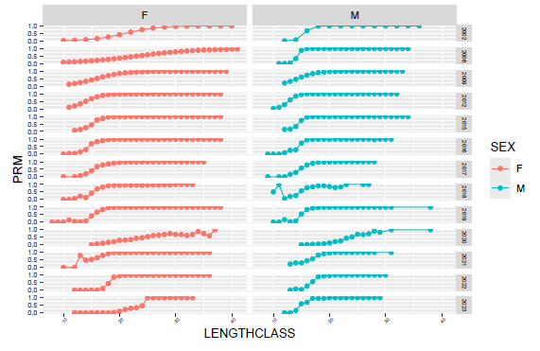
Maturity
The data pairs of length and maturity stage are used to estimate the parameters of the classical maturity ogive for males and females respectively, according to the model:
where _{pm,L} indicates the proportion of mature individuals per length class _{Li}, g is the curvature parameter and _{Lm50%} represents the length at which 50% of the individuals are sexually mature
Maturity ogive parameters are calculated by non-linear best-fit estimation obtained by minimising the sum of the quadratic deviation between observed and expected values.

Slide 15
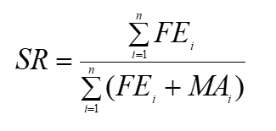
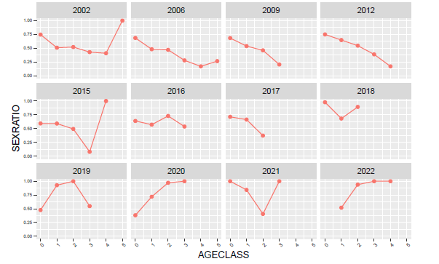
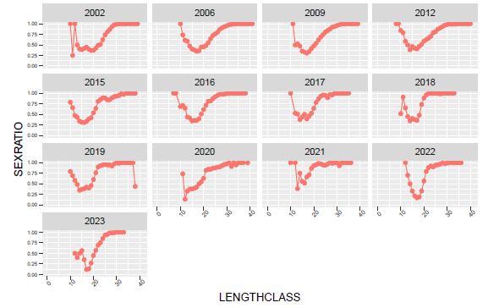
Sex ratio
The sex ratio is calculated as the ratio of the number of females to the total number of sexed individuals (females + males). This ratio can be estimated globally, expressed here as a single value, given by the number of females over the total number of individuals, as in the following formulation:
where FE are the females, MA the males and i indicates the different length classes. In addition, sex ratio values will also be estimated by size or age class.

Slide 16
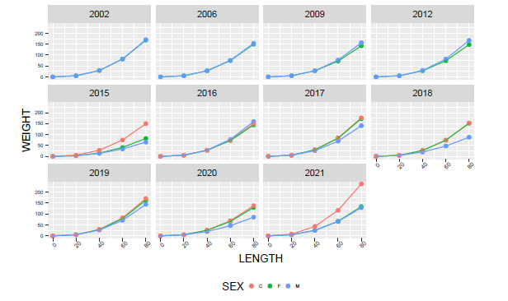
Length weight relationship (parametrs a and b)
The length-weight relationship is described by the following power equation:
P= a*L^{b} where a is an empirically defined constant and b is the exponent.
The relationship is computed both for separate sexes and for combined sexes (M+F+U) yearly.
The curve could be also linearised by means of a logarithmic transformation of the data and a linear regression fit:
Ln P = Ln a + b(Ln L).

Slide 17


